Slide 1
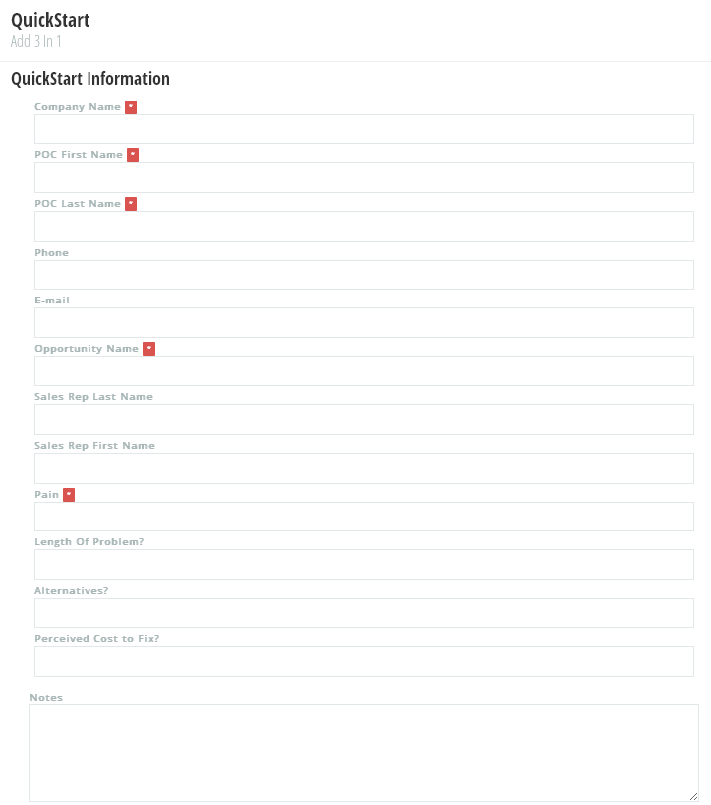
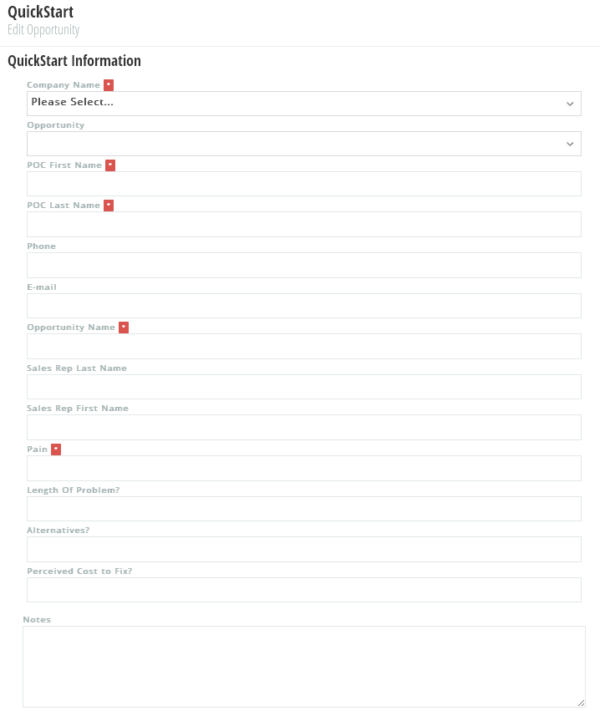
QuickStart – New Customer
1
QuickStart – New Customer
Add 3-in-1: Customer, Contact & Opportunity
2
3
4
5
6
7
Opportunity Status
8
9
10
11
12
13
14
15

Slide 2
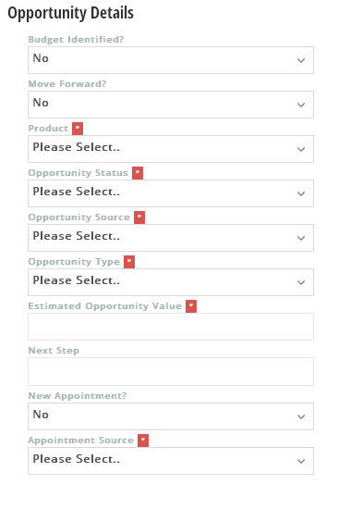
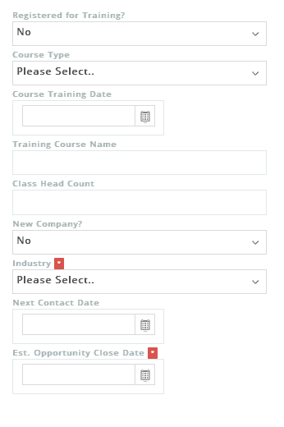

QuickStart – New Customer
This is the screen if “Who is Registered for Training?” field is selected as “No One”
16
Yes
26
17
27
18
Who is Registered for Training?
28
Please Select..
19
29
Training Course Date
20
30
21
31
Win Probability Percent
22
Training Course Location
32
Weighted Opportunity Value
23
33
24
Yes
34
25
35
36
37
Note: - Need to move the “Clear” and “Save” buttons up so the wording is centered in the boxes

Slide 3
QuickStart – New Customer
This is the screen if “Who is Registered for Training?” field is selected as “Individual” or “Group”
16
Yes
26
17
27
18
Who is Registered for Training?
28
Please Select..
19
29
Training Course Date
20
30
21
31
Win Probability Percent
22
Training Course Location
32
Weighted Opportunity Value
23
33
24
Yes
34
25
35
36
37
Note: - Need to move the “Clear” and “Save” buttons up so the wording is centered in the boxes

Slide 4

QuickStart – New Customer (“Save” popup #1)
When the user selects “Save”, this is the popup screen if the “Company Name” entered is already in the database
Yes
Who is Registered for Training?
Please Select..
38
This Company already exists. Click “Save” to continue and update the Contact and Opportunity records for this company with the information you have provided.
Save
Training Course Date
This Company already exists. Click “Edit” to go back and edit the Company Name for this record before saving.
Edit
Win Probability Percent
Training Course Location
39
Weighted Opportunity Value
Yes
Note: - Need to move the “Clear” and “Save” buttons up so the wording is centered in the boxes

Slide 5
QuickStart – New Customer (“Save” popup #2)
When the user selects “Save” after the “Company Name” popup screen confirmation, this popup will ask if the user wants to send a meeting invite
Yes
Who is Registered for Training?
Please Select..
40
Would you like to send a meeting invite to the company Point of Contact now?
Yes
Training Course Date
No
Win Probability Percent
Training Course Location
Weighted Opportunity Value
Yes
Note: - Need to move the “Clear” and “Save” buttons up so the wording is centered in the boxes

Slide 6
QuickStart – New Customer (“Save” popup #3)
Whether the user selects “Yes” or “No” regarding the “send email” question, this popup will ask if the user wants to create another opportunity for this same company now
Yes
Who is Registered for Training?
Please Select..
41
Would you like to create another opportunity for this same company at this time?
Yes
Training Course Date
No
Win Probability Percent
Training Course Location
Weighted Opportunity Value
Yes
Note: - Need to move the “Clear” and “Save” buttons up so the wording is centered in the boxes

Slide 7
QuickStart – Existing Customer
QuickStart – Existing Customer
1
Edit Existing [or Add New] Contact & Opportunity
2
Edit Existing or Add New
3
4
Opportunity Name
5
Opportunity Status
6
POC First Name
7
POC Last Name
8
9
10
Sales Rep
11
12
13
14
15
16

Slide 8

QuickStart – Existing Customer
This is the screen if “Who is Registered for Training?” field is selected as “No One”
17
29
18
Who is Registered for Training?
30
Please Select..
19
31
20
Training Course Date
32
21
33
22
Training Course Location
34
Actual Opportunity Value
23
Win Probability Percent
35
24
Weighted Opportunity Value
Yes
36
25
37
26
38
27
Actual Close Date
28
39
Why Was Opportunity Lost?
40
Notes History
42
Previous Notes
Created By
Created Date
41
Note #1: Need to move the “Clear” and “Save” buttons up so the wording is centered in the boxes
Note #2: “Actual Opportunity Value” is ONLY a required field when the “Opportunity Status = Closed Won”
Note #3: “Actual Close Date” is ONLY a required field when the “Opportunity Status = Closed Won or Closed Lost”
Note #4: “Why Was Opportunity Lost?” is ONLY a required field when the “Opportunity Status = Closed Lost”

Slide 9
QuickStart – Existing Customer
This is the screen if “Who is Registered for Training?” field is selected as “Individual” or “Group”
17
29
18
Who is Registered for Training?
30
Please Select..
19
31
20
Training Course Date
32
21
33
22
Training Course Location
34
Actual Opportunity Value
23
Win Probability Percent
35
24
Weighted Opportunity Value
Yes
36
25
37
26
38
27
Actual Close Date
28
39
Why Was Opportunity Lost?
40
Notes History
42
Previous Notes
Created By
Created Date
41
Note #1: Need to move the “Clear” and “Save” buttons up so the wording is centered in the boxes
Note #2: “Actual Opportunity Value” is ONLY a required field when the “Opportunity Status = Closed Won”
Note #3: “Actual Close Date” is ONLY a required field when the “Opportunity Status = Closed Won or Closed Lost”
Note #4: “Why Was Opportunity Lost?” is ONLY a required field when the “Opportunity Status = Closed Lost”

Slide 10
QuickStart – Existing Customer (“Save” popup #1)
When the user selects “Save” after editing an existing opportunity or adding a new one for an existing company, this popup will ask if the user wants to send a meeting invite
17
29
18
Who is Registered for Training?
30
Please Select..
19
31
20
Training Course Date
32
21
43
33
22
Training Course Location
Yes
Actual Opportunity Value
Would you like to send a meeting invite to the company Point of Contact now?
34
23
No
Win Probability Percent
35
24
Weighted Opportunity Value
Yes
36
25
37
26
38
27
Actual Close Date
28
39
Why Was Opportunity Lost?
40
Notes History
42
Previous Notes
Created By
Created Date
41
Note #1: Need to move the “Clear” and “Save” buttons up so the wording is centered in the boxes
Note #2: “Actual Opportunity Value” is ONLY a required field when the “Opportunity Status = Closed Won”
Note #3: “Actual Close Date” is ONLY a required field when the “Opportunity Status = Closed Won or Closed Lost”
Note #4: “Why Was Opportunity Lost?” is ONLY a required field when the “Opportunity Status = Closed Lost”

Slide 11
QuickStart – Existing Customer (“Save” popup #2)
Whether the user selects “Yes” or “No” regarding the “send email” question, this popup will ask if the user wants to add or edit another opportunity for this same company now
17
29
18
Who is Registered for Training?
30
Please Select..
19
31
20
Training Course Date
32
21
44
Edit
33
22
While working with this same company would you like to:
a. Edit another existing opportunity for this same company?
b. Add another new opportunity for this same company?
c. Exit QuickStart?
Training Course Location
34
Actual Opportunity Value
23
Add
Win Probability Percent
Exit
35
24
Weighted Opportunity Value
Yes
36
25
37
26
38
27
Actual Close Date
28
39
Why Was Opportunity Lost?
40
Notes History
42
Previous Notes
Created By
Created Date
41
Note #1: Need to move the “Clear” and “Save” buttons up so the wording is centered in the boxes
Note #2: “Actual Opportunity Value” is ONLY a required field when the “Opportunity Status = Closed Won”
Note #3: “Actual Close Date” is ONLY a required field when the “Opportunity Status = Closed Won or Closed Lost”
Note #4: “Why Was Opportunity Lost?” is ONLY a required field when the “Opportunity Status = Closed Lost”

